Slide 1
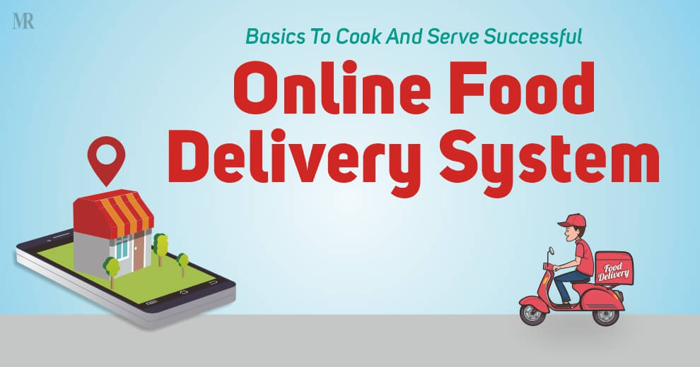
“ Food delivery website and application”

Slide 2
Food delivery website and application
▪
A Food delivery app that provides food delivery at your door in very less time and with the best packaging.
LMS Username | Name | Batch
 | H.Akshaya | 09
 | S.Sumiya Fathima | 09
 | G.Devisri | 09
 | s.Livesha | 09

Slide 3
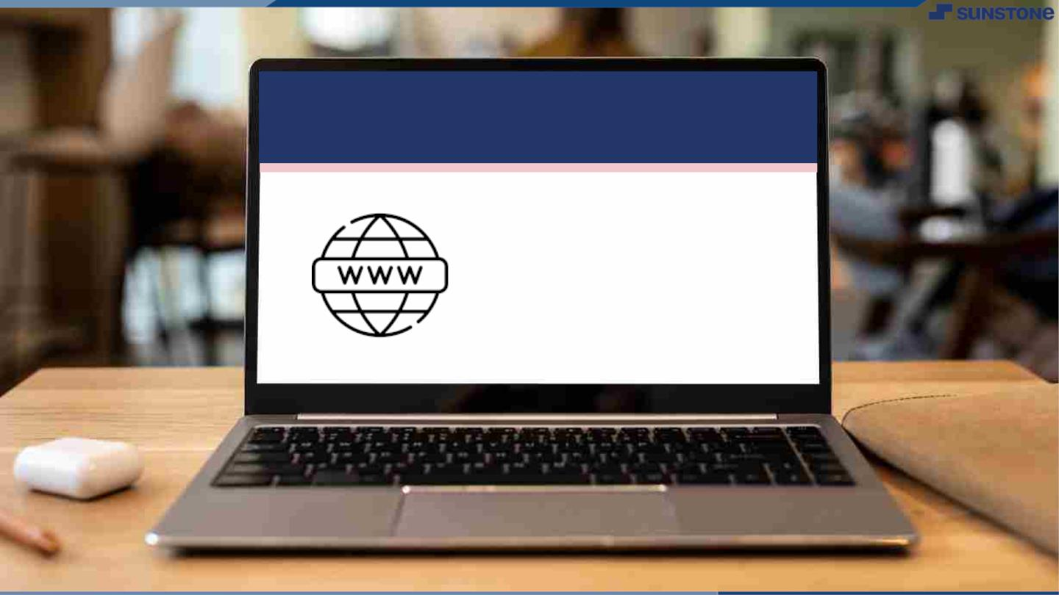
Submission Github
https://github.com/liveshasaravanan22/NM-SPCET-CSE-GROUP09#nm-spcet-cse-group09

Slide 4


